Slide 1
Suncorp Take Home Assignment
Claim Prediction
Yuzhou Zhang

Slide 2
Table Of Content
Project Overview
Solution Design
Exploratory data analysis
Model
Summary

Slide 3
Project Overview
Background: Claim handlers spend significant time on cost estimates and managing reserves, which are often inaccurate and inconsistent, highlighting the need for early detection and proper triage of complex claims.
Problem:
- Inaccurate Estimates
- Difficulty in Identifying Complex Claims
Goal:
- Improve Estimate Accuracy
- Early Detection and Triage Complex Claims

Slide 4
Solution Design
How To Identify Claim Type?
How To Ensure The Accuracy?
Claim Type Identifier
Claim Cost Prediction Model
Claim
How To Find The Right Person?
Complex Claim
Claim Handler

Slide 5

Solution Design –Claim Cost Prediction
Goals:
- Accurate Claim Cost
New Claim
Claim Amount
Model
Data Analysis
Feature Engineering
Model Selection
Historical Claim Records
Historical Claim Records
Historical Claim Records
Historical Claim Records
Historical Claim Records
Historical Claim Records
Historical Claim Records
Historical Claim Records
Historical Claims

Slide 6

Solution Design – Complex Claim Type Detection
Goals:
- Early Detect
- Faster
- Send to Right Person
Map into cluster
Claim
Claim
Claim
Claim
New Claim
Claim
Claim
New Claim
Find Right Person
Find Similar Claims in the Same Cluster
Pretrained Clustering Model
Analysis Cluster to Define Complex Claim
Historical Claim Records
Historical Claim Records
Historical Claim Records
Historical Claim Records
Historical Claim Records
Historical Claim Records
Historical Claim Records
Historical Claim Records
Historical Claims

Slide 7
Exploratory Data Analysis
Time Series Data
Personal Data
Employment Data
Claim Cost

Slide 8
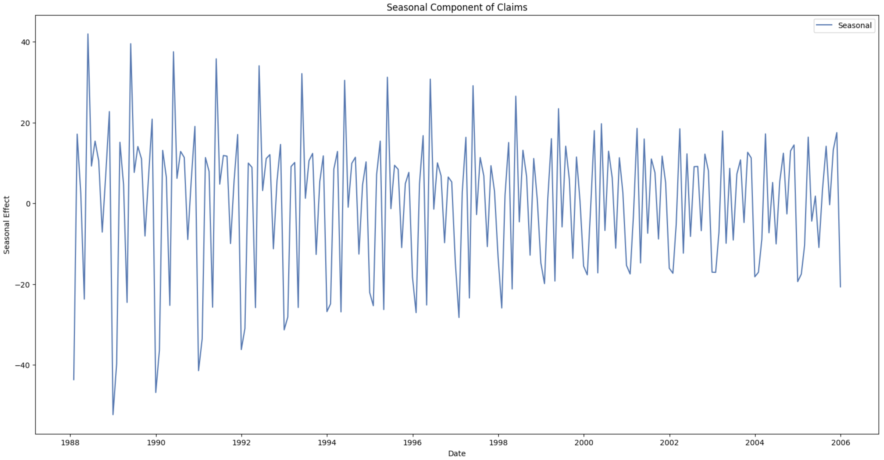
Time Series Data
Features: DateTimeOfAccident, DateReported
Seasonal
Inflation

Slide 9
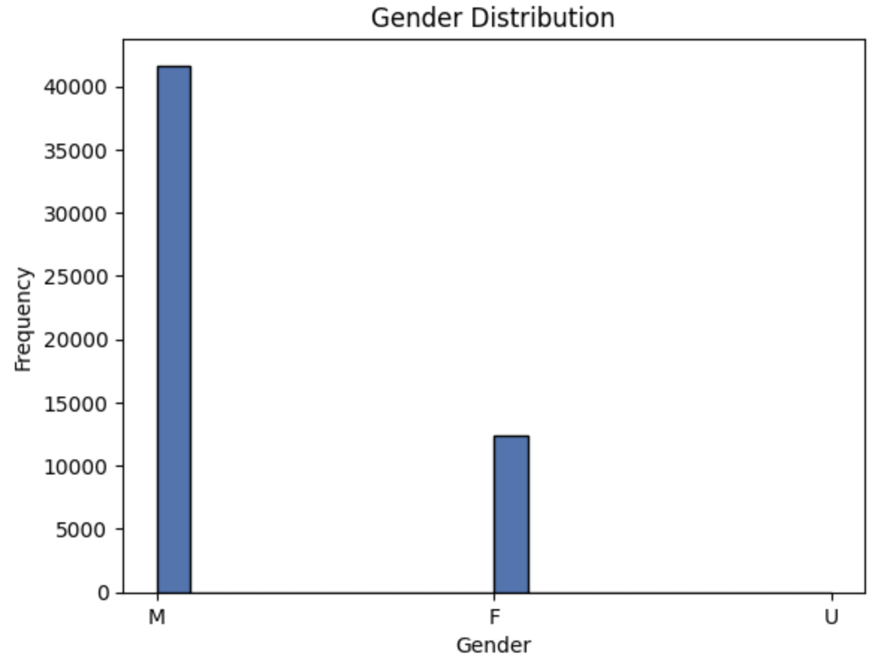
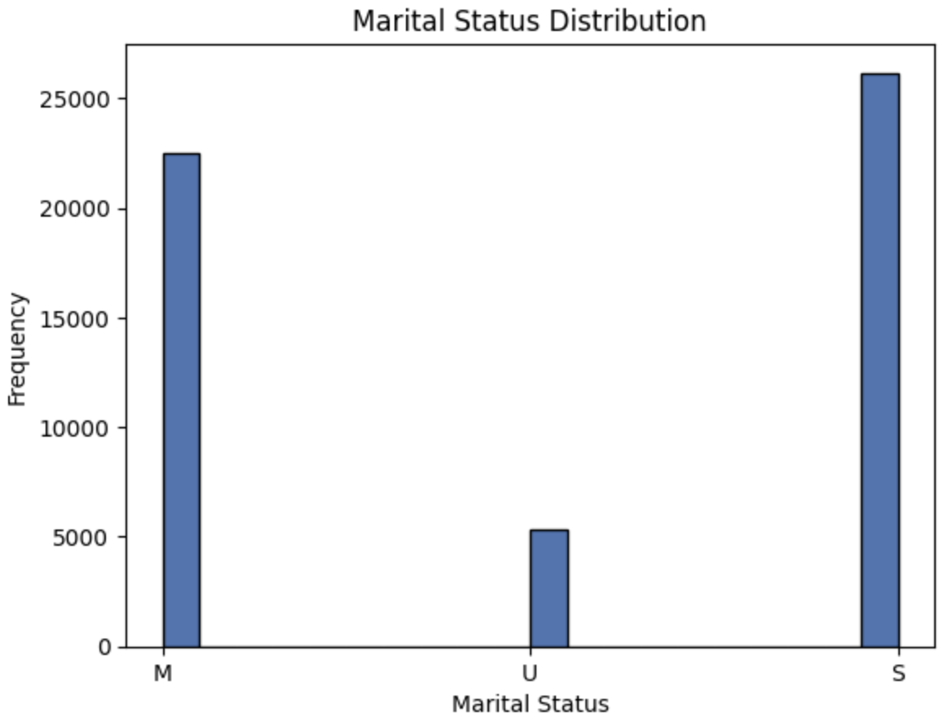
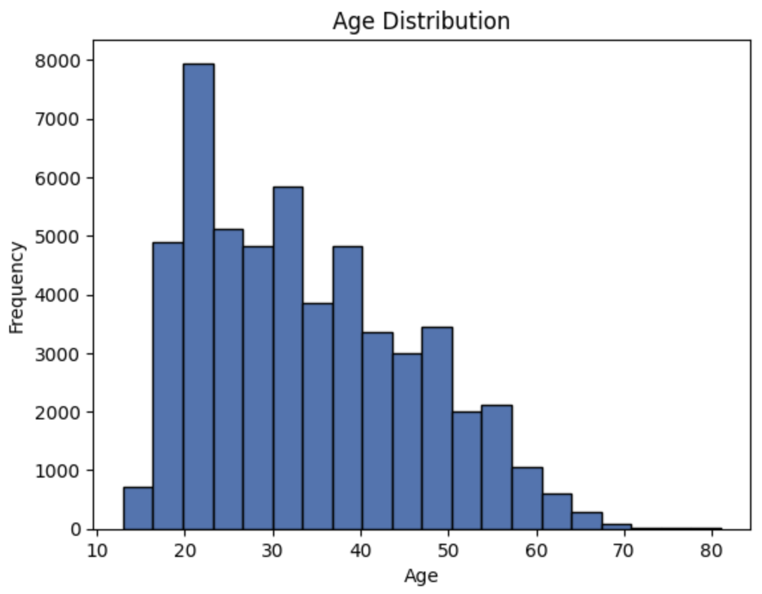
Personal Data
Features: Gender, MaritalStatus, Age, DependentChildren, DependentsOther

Slide 10
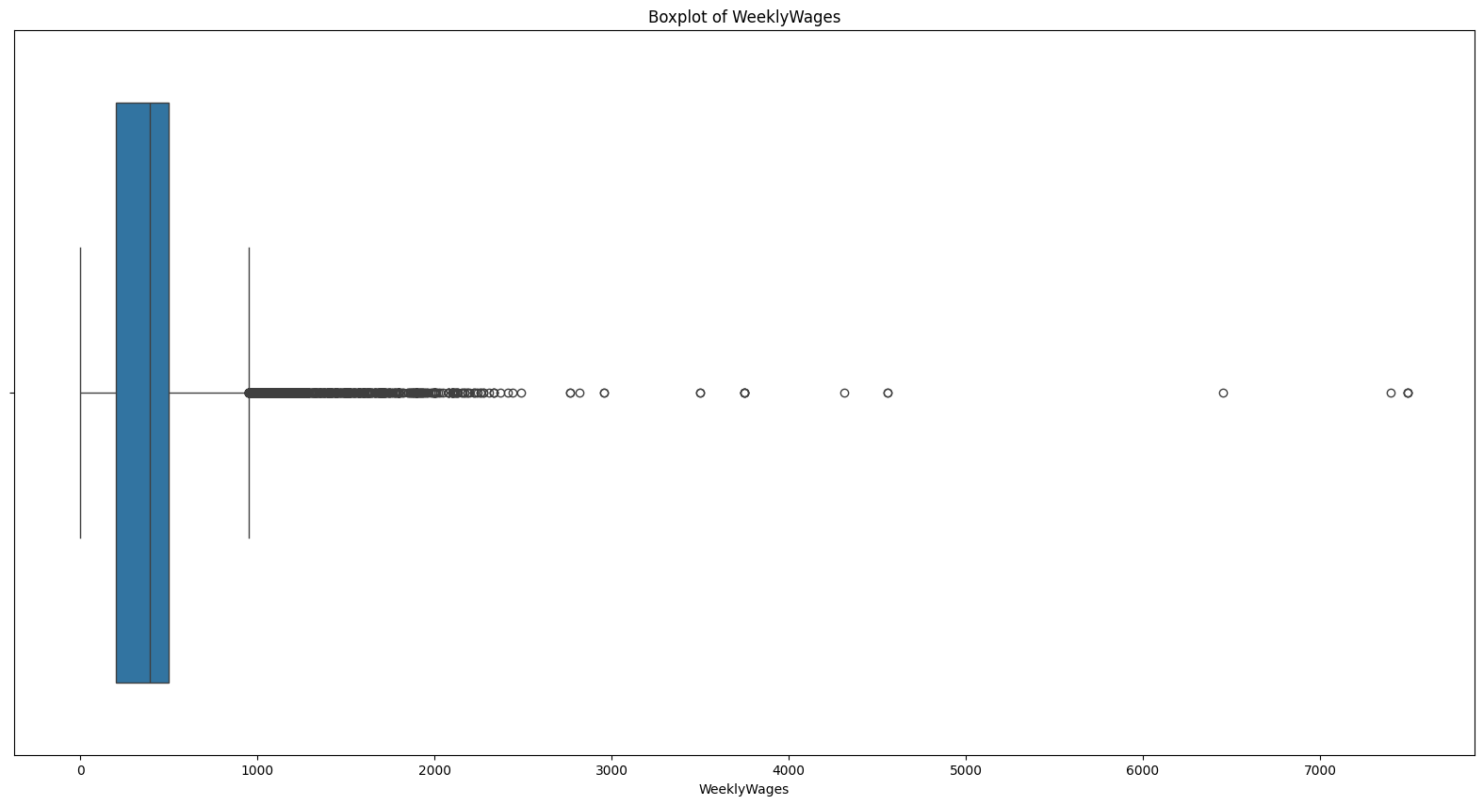
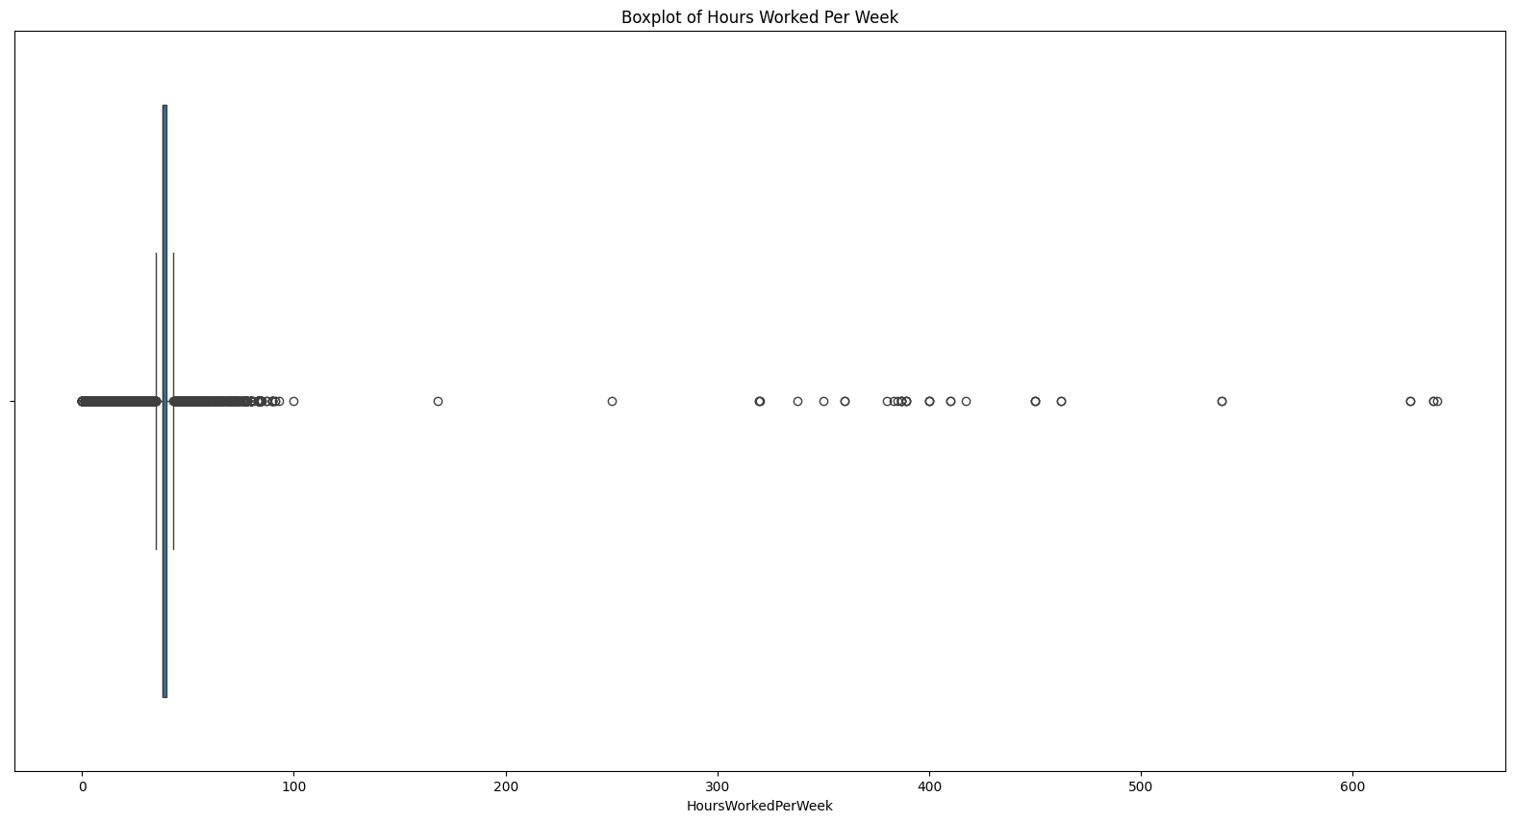
Employment Data
Features: PartTimeFullTime, WeeklyWages, HoursWorkedPerWeek, DaysWorkedPerWeek
Outlier in WeeklyWages: pay more than 1000 per week
Outlier in HoursWorkedPerWeek: work more than 100 hours per week

Slide 11
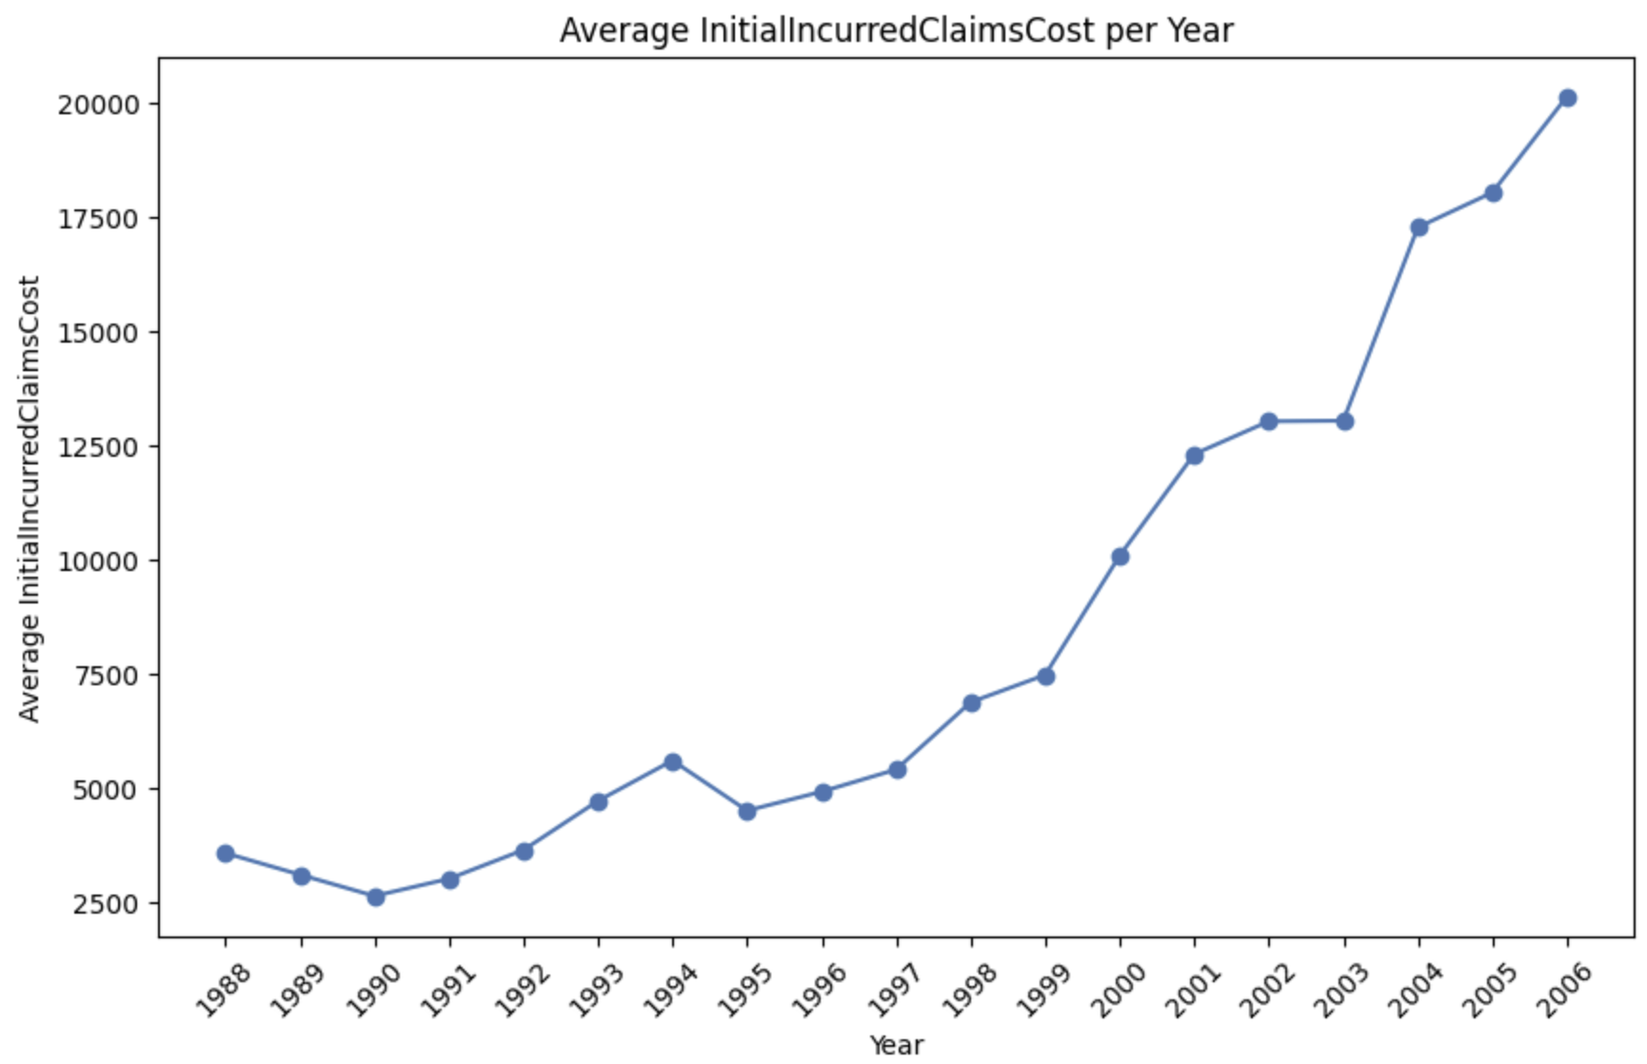
Claim Cost Data
Features: UltimateIncurredClaimCost, InitialIncurredClaimsCost

Slide 12
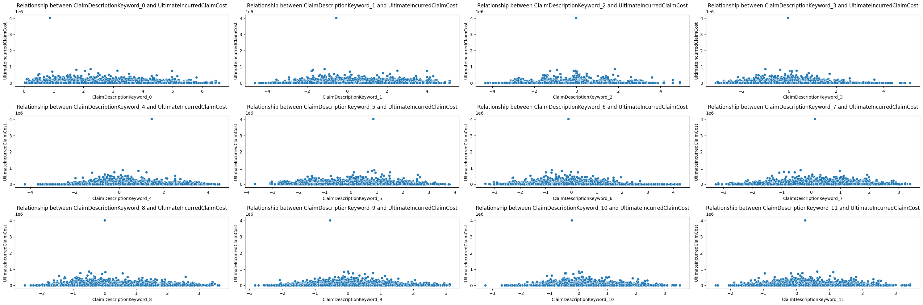
Claim Description Keyword
Features: ClaimDescriptionKeyword_*

Slide 13
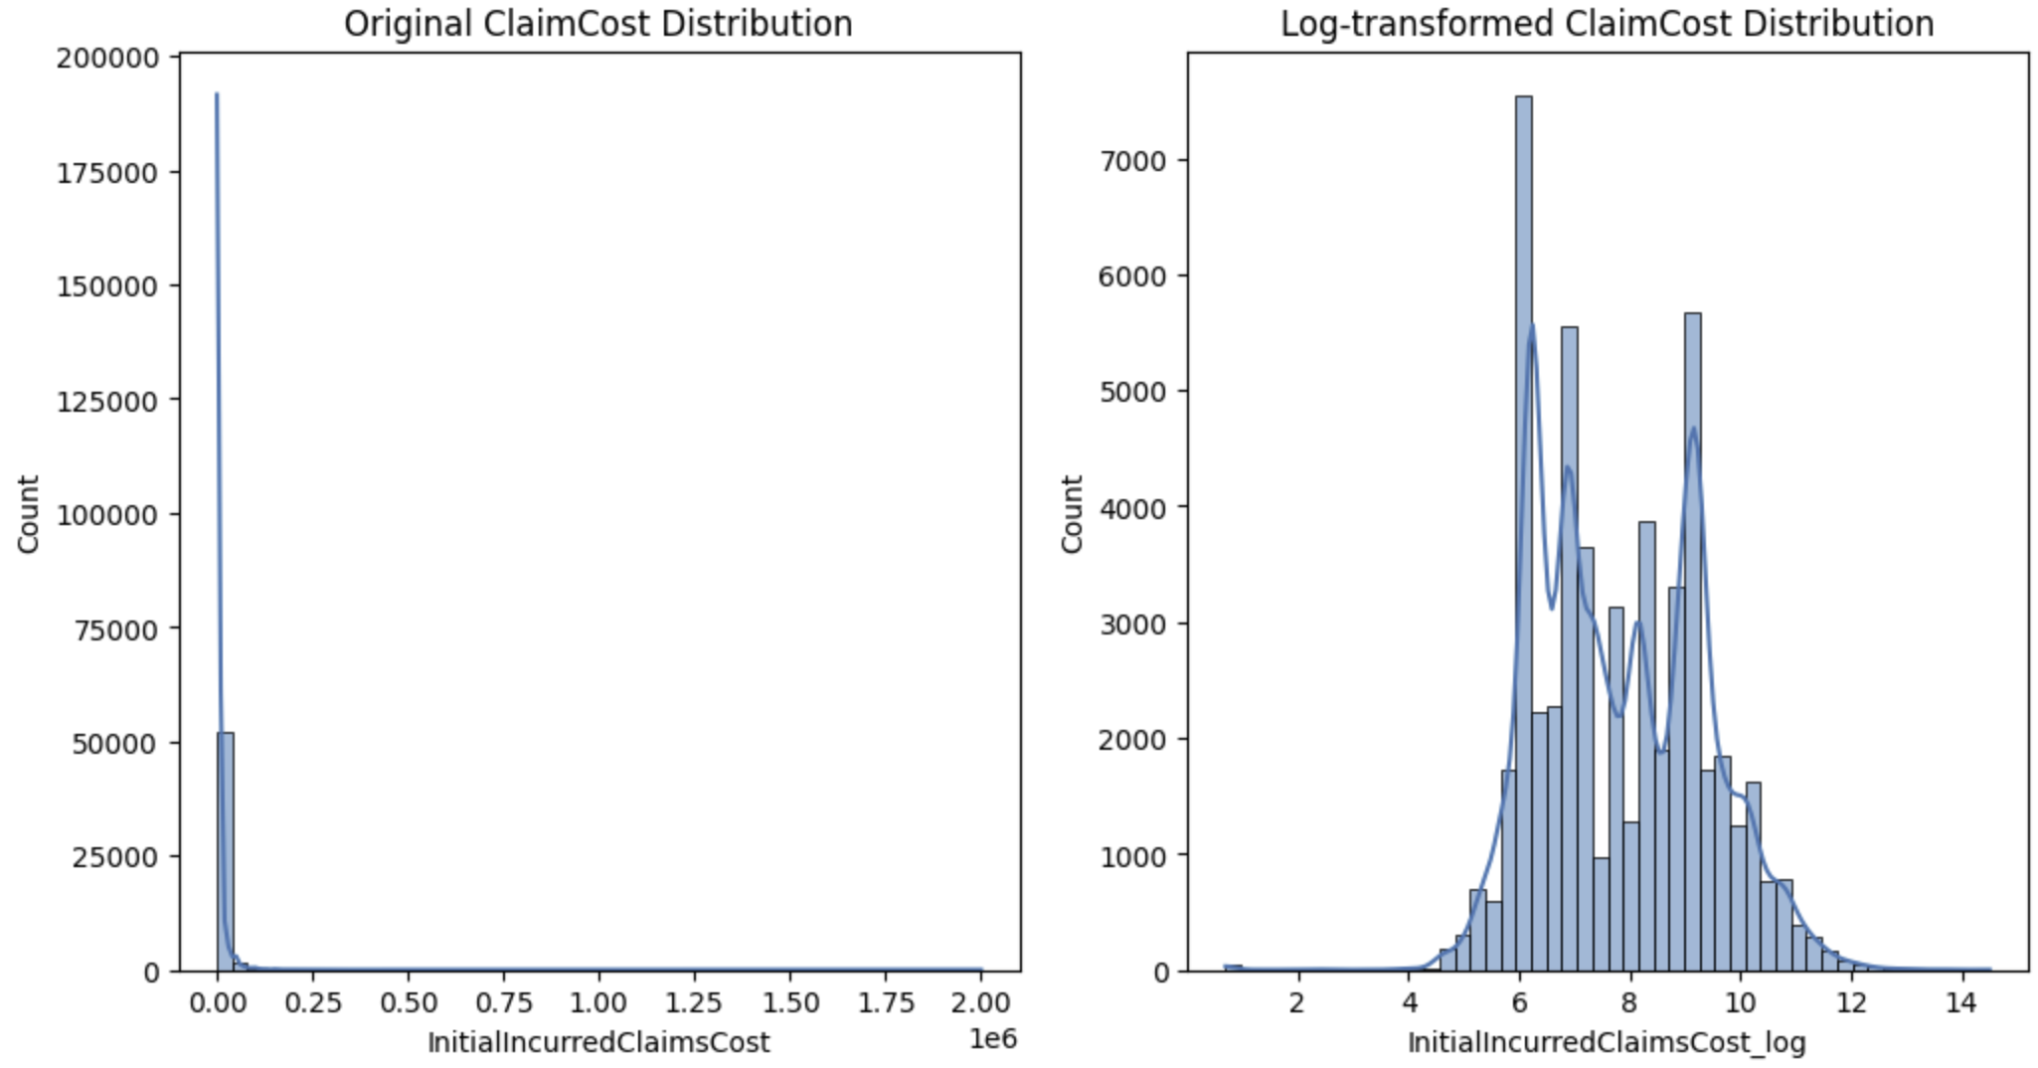
Claim Cost Data
Features: UltimateIncurredClaimCost, InitialIncurredClaimsCost

Slide 14
Feature Engineering
Client – Message Feature
The client-message is trying to build the features at the client level by combine client data, customer data and message data.
Customer - Message Feature
The customer-message is trying to build the features at the customer level by combine client data, customer data and message data.
Time Features
WeekDayOfAccident
MonthOfAccident
YearOfAccident
HourOfAccident
MonthOfReport
MonthOfReport
YearOfReport
IntervalofDay
IntervalofYear
Personal Data Feature
Age
DependentChildren
DependentsOther
MaritalStatus
AgeCategory
TotalDependents
Employment Data Features
WeeklyWages
HoursWorkedPerWeek
DaysWorkedPerWeek
PartTimeFullTime
HourlyWages
DailyWages
Overtime
WageCatgory
Claim Cost
InitialIncurredClaimsCost
InitialIncurredClaimsCost_log

Slide 15
Model & Result
Claim cost prediction model
Claim type detection model

Slide 16
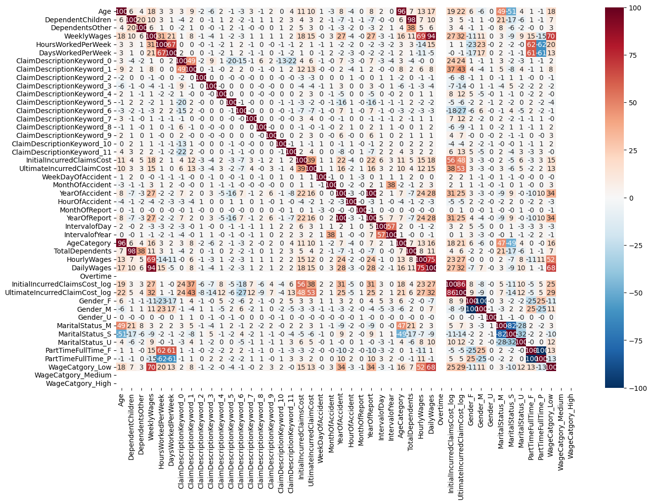
Model - Feature Correlations Map
Feature Selection Strategy

Slide 17
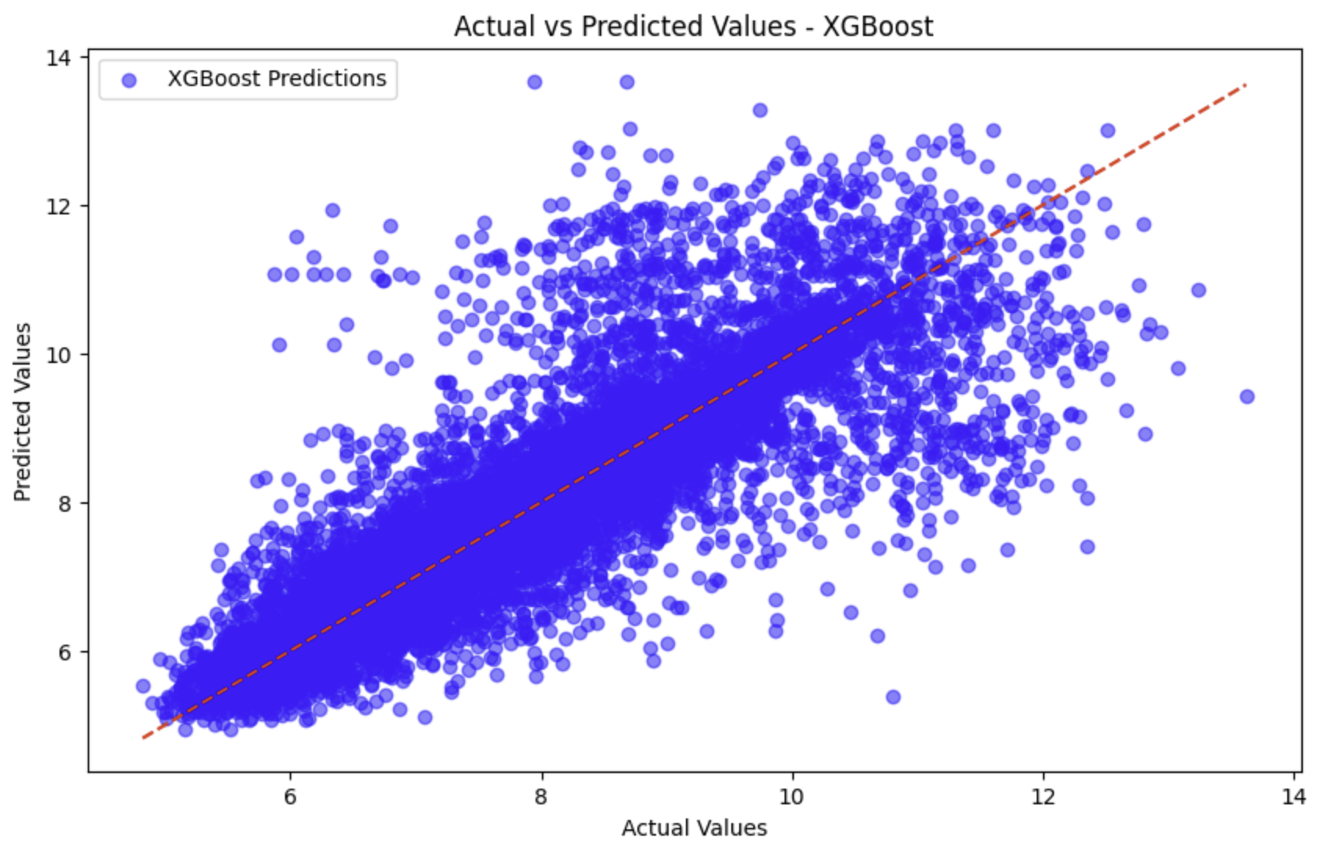
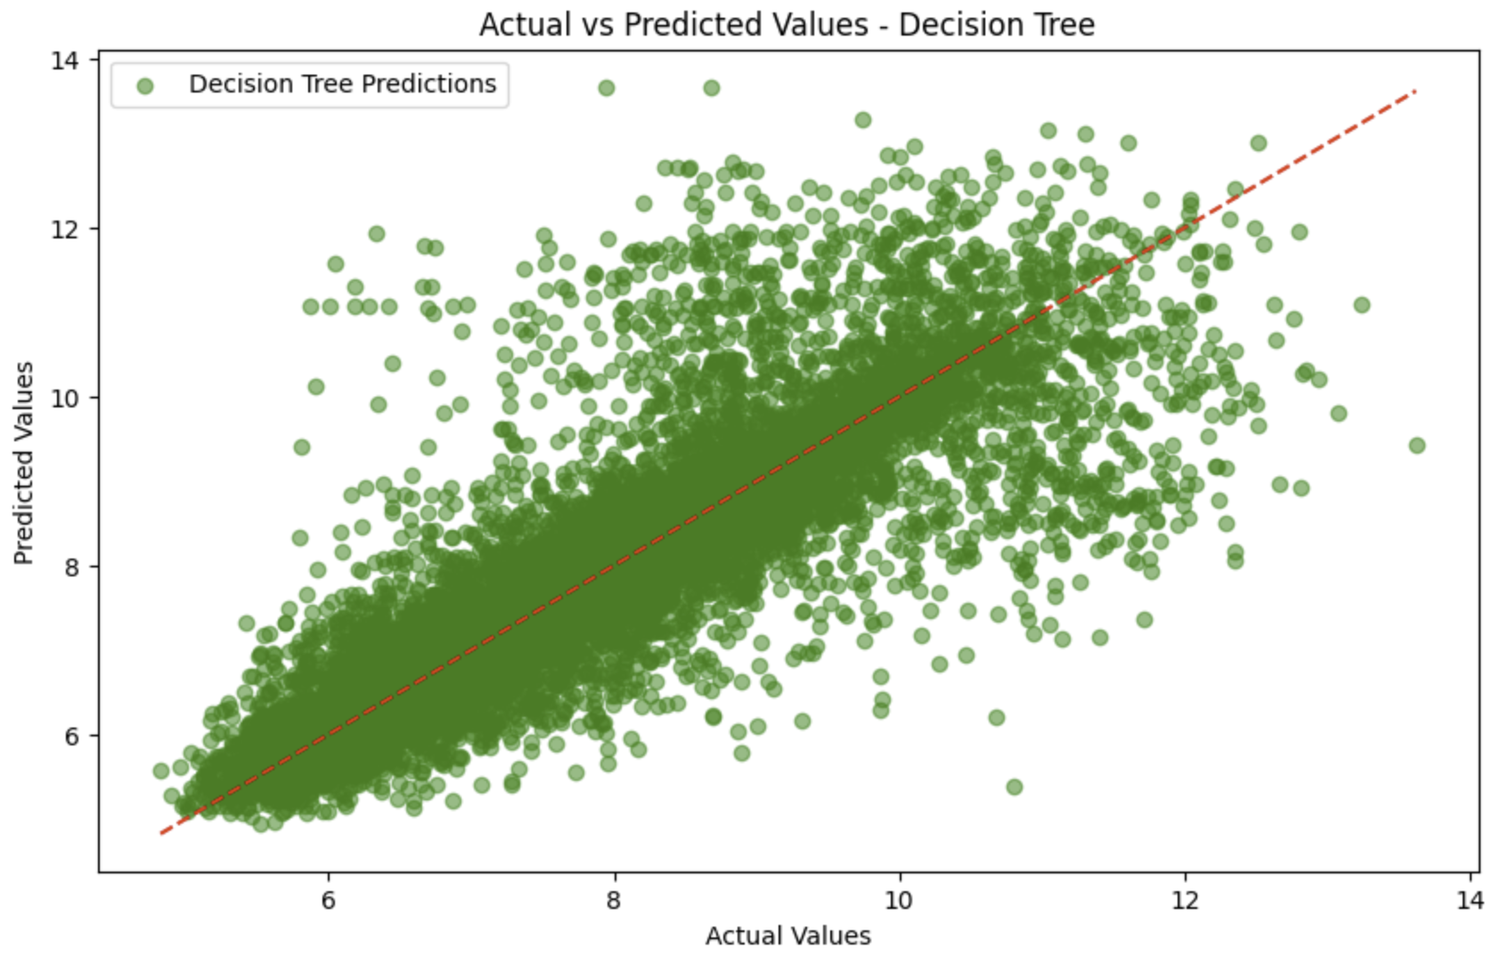
Model – Claim Cost Prediction
Model Selection: XGBRegression, DecisionTree
Objective Function: MSE
Hyperparameter Tunning: hyperopt
Best Hyperparameters: {'colsample_bytree': 0.84, 'gamma': 0.57, 'learning_rate': 0.034, 'max_depth': 7, 'min_child_weight': 8.0, 'n_estimators': 234, 'reg_alpha': 1.84, 'subsample': 0.55}
Mean Squared Error: 515623438.830164
Mean Squared Error: 1344223965.6524138
Summary: The XGBoost model outperforms the Decision Tree model in predicting claim costs, as evidenced by the significantly lower Mean Squared Error (MSE). The scatter plot for XGBoost shows a tighter clustering around the ideal fit line compared to the Decision Tree model, indicating better predictive accuracy.

Slide 18
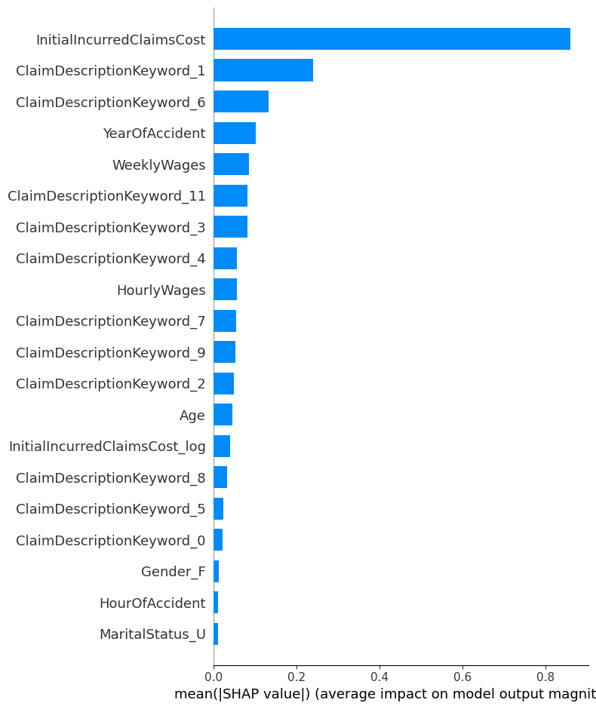
Model – Claim Cost Prediction
Feature Importance

Slide 19
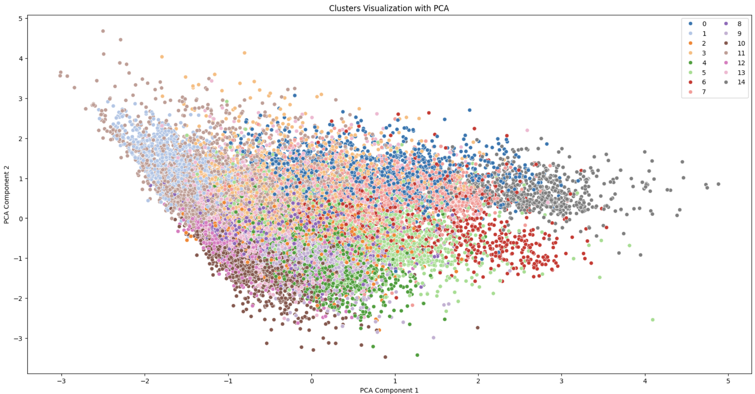
Model – Complex Claim Detection
Model Selection: K-Mean
Find Best K: Silhouette Score
Best K: 15
Features: ClaimDescriptionKeyword_*

Slide 20
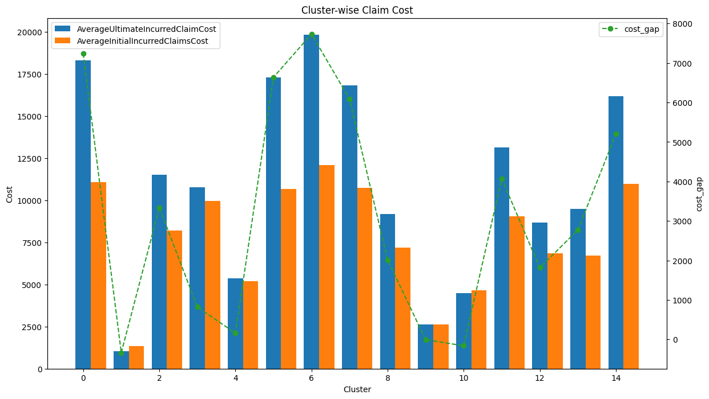
Model – Complex Claim Detection
Cluster Analysis
Based on the cost gap between the Average Ultimate Incurred Claim Cost and the Average Initial Incurred Claim Cost, Clusters 0, 2, 5, 6, 7, 11, 14 are identified as complex claim clusters, each with a cost gap exceeding 3000.
So, in the inferring process, if one claim mapped in the complex claim cluster, we will identify this claim as complex cluster.

Slide 21
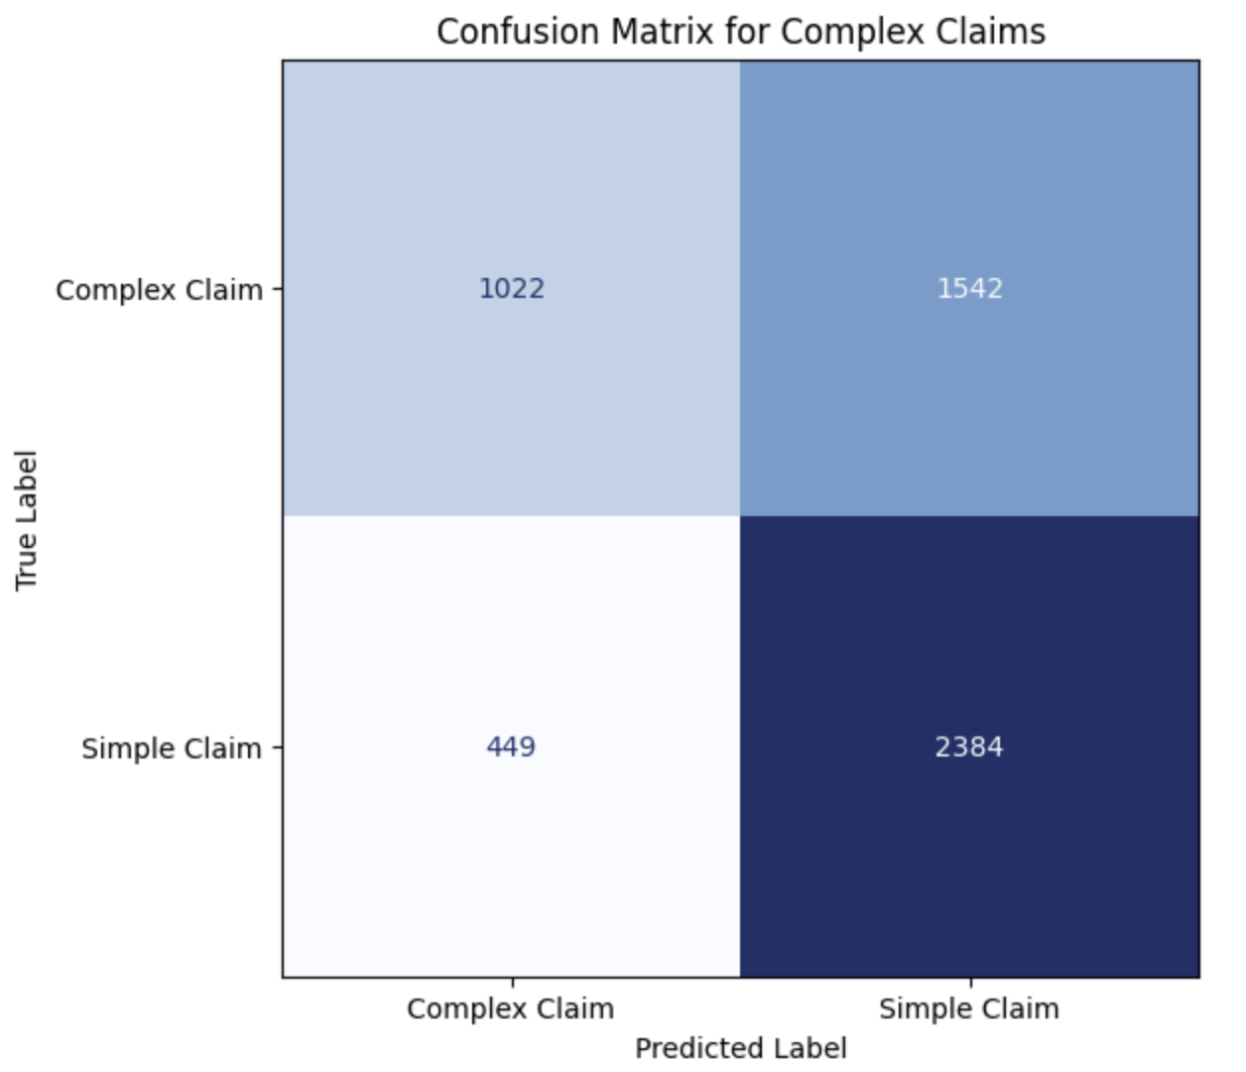
Model – Complex Claim Detection Result
Validation Workflow
Validation Result
Data
Test data preparation.
Label
Label complex claim based on the threshold.
Clustering
Map claims to clusters.
Validation
Comparing results between cluster label and actual label.
Assumption: Since there is no source of truth data to determine if a claim is complex, when validating the results from the K-means prediction, we will assume a claim is considered complex if the cost gap between the initial claim and the ultimate claim exceeds 3000.
Precision: 0.69
Recall: 0.39

Slide 22
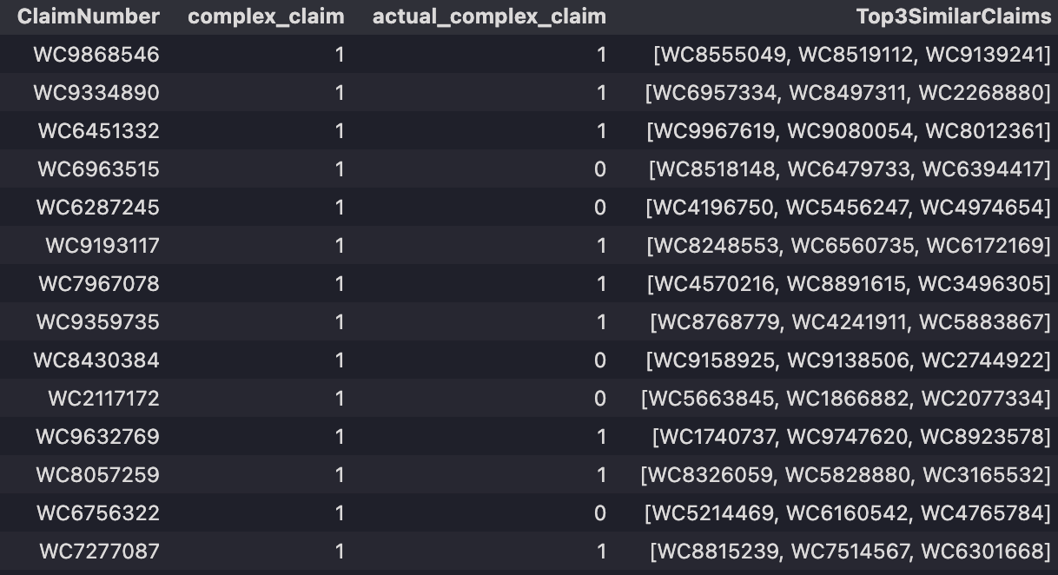
Model – Target to Right Person
Method: Calculate the distance between features from claims
Sample Results:

Slide 23
Summary
Implement XGBRegressor for claim cost prediction, achieving performance approximately 40% better than the Decision Tree model.
Implement the K-means algorithm to group claims into different clusters for identifying complex claims. Utilize the distance between features for each claim to find similar claims and forward them to the claim handlers.
What’s next?
Collect additional text data to improve performance.
Gather historical claims for the same individual.
Implement rule-based logic to identify complex claims.

